Slide 1
Annual Quantity (AQ)
45

Slide 2
How does the rolling AQ Process Work?
46

Slide 3
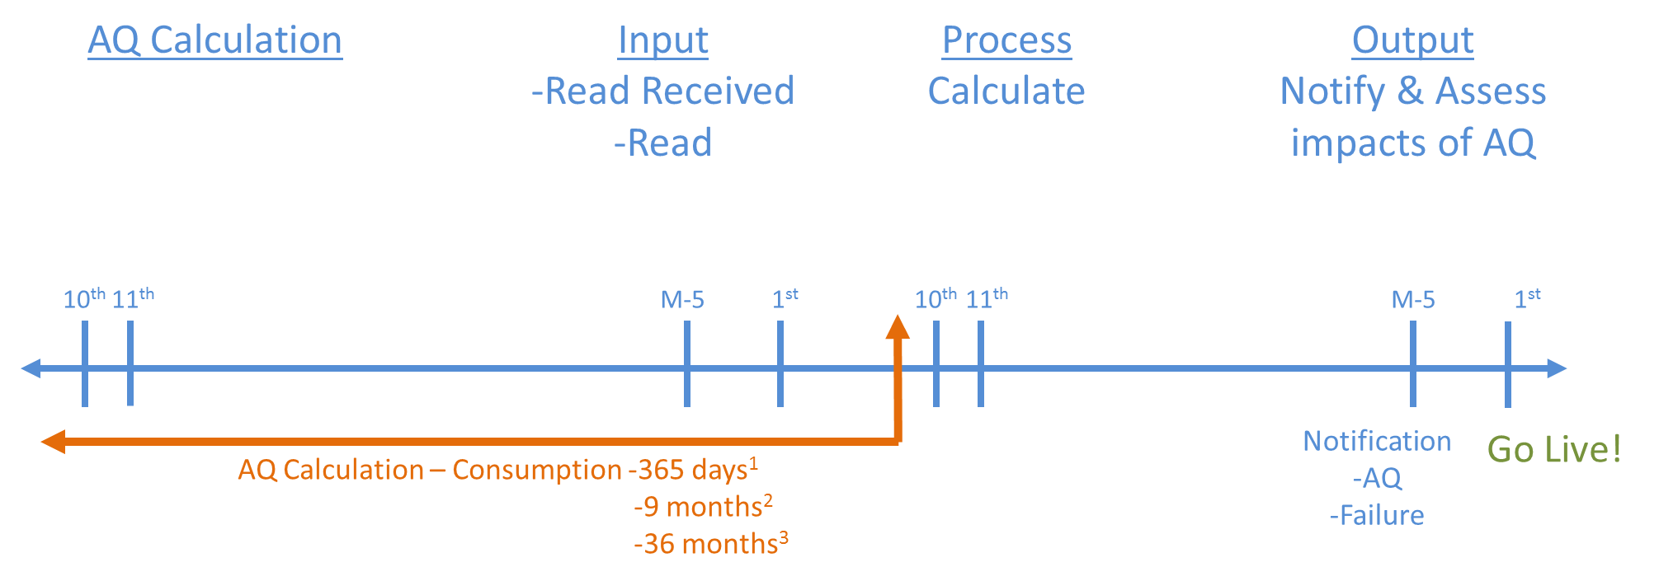
AQ Calculation Process
The AQ Calculation will be triggered by a valid read
Valid / closed out reads need to have been submitted on or before the 10th calendar day of the month to be considered for that months AQ calculation (performed on the 11th)
If the AQ Value cannot be calculated the previous AQ value will apply and notification will be issued
Isolated Supply Meter Points will not calculate
New Supply Meter Points are not eligible for an AQ Calculation for a period of 9 months
All AQ Notifications will be issued at M-5
47

Slide 4
What if I want to correct my AQ?
48

Slide 5
AQ Correction process
AQ correction using the AQI File
Registered Shipper can request a change in AQ via the AQ Correction Process for the following reasons
  Confirmed Theft - Reason Code 1
  Change in Consumer Plant – Reason Code 2
  Commencement of New Business – Reason Code 3
  Tolerance Change – Reason Code 4
  Winter Consumption Correction – Reason Code 5
Accepted AQ value will be changed with effect from the first of the month following the request being accepted. The User will receive an AQR file confirming acceptance or rejection of the AQ correction request. The User will also be notified of the AQ change via the NRL File at M-5.
A backstop date is applied when the AQ is corrected. Therefore the AQ cannot be corrected for a further 9 months.
49

Slide 6
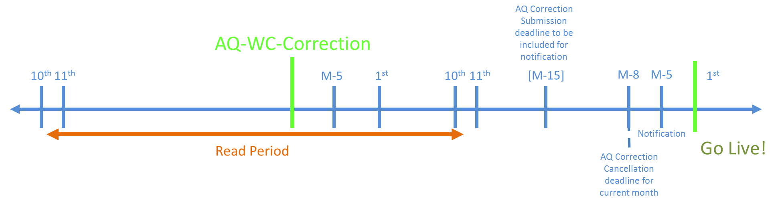
AQ Correction Process
The AQ/Winter consumption correction submission has a close out date, this is the latest date the AQ Correction can be submitted to become effective on the first of the next month. However the AQ Correction requests submitted after close out date will not be rejected, but the corrected AQ in these cases will be effective on the 1st of the next month.
These will:
Trigger the Offer Addendum process
Update the Formula Year AQ
Create a Backstop Date
50

Slide 7
AQ Correction Process Continued
AQ Correction Close Out
Latest Date the AQ Correction can be submitted to become effective on 1st of next month
AQ Corrections received after close-out are applied in the following month
Example
AQ Correction is submitted and accepted on M-15 in June (Close out Date) becomes effective on 1st July.
AQ Correction submitted after the M-15 becomes effective on 1st August
51

Slide 8
AQ Correction Cancellation
AQ Correction Cancellation
The AQ Correction can be cancelled up to and including M-8 (business days) of going live
Example
AQ Correction Cancellation must be submitted no later than M-8 in June to prevent the Correction going live on the 1st of July.
Cancellation received after M-8 in June will not stop the AQ Correction from going live.
52

Slide 9
Is this for all SMPs?
53

Slide 10
NDM Formula Year (AQ Bill)
With the introduction of rolling AQ for all classes, there is the potential for AQ to be revised each month. In order to provide a stable AQ for billing purposes, the Formula Year AQ or AQ Bill is used to determine the rates for Class 3 and 4 sites.
A snapshot of AQ is taken on 1st December. AQ Bill is revised using this snapshot on 1st April unless an AQ correction has been applied in the interim period.
1st April
AQ Bill (Formula Year AQ) updated with values from the snapshot taken on the 1st December unless an
AQ Correction has been accepted.
AQ Live
AQ Live
AQ Live
February
March
January
April
AQ Live
AQ Live
1st December
AQ Snapshot taken
December
May
AQ Live
AQ Live
54

