Slide 1
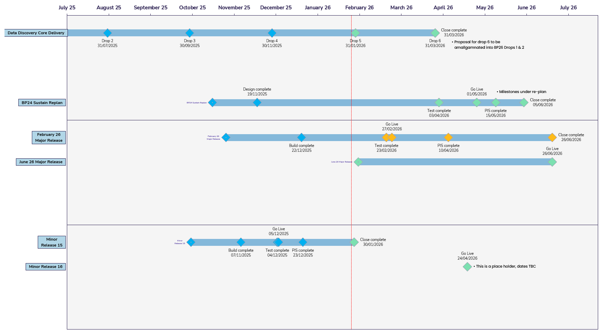
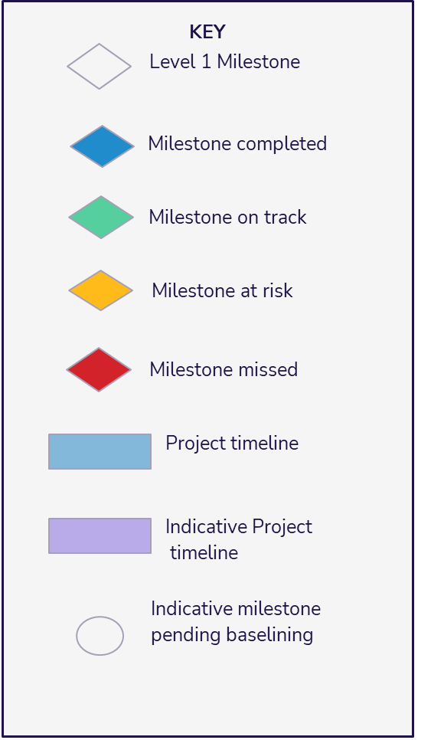
Portfolio Plan On a Page
Version: 1
Issued: 22/12/2025
Uncontrolled when printed
© Xoserve
Notes:
Add bullets

