Slide 1
Invoicing Overview for Shippers

Slide 2
Contents
1. Introduction to Invoicing
  1.1 Introduction and Purpose of Document
  1.2 Transportation: National Transmission System
  1.3 Infrastructure Map
  1.4 Invoicing Principles
  1.5 Introduction to Charges and Invoices
  1.6 Charge Concepts
2. Invoice Files Overview
  2.1 Introduction
  2.2 File Format Principles: Transportation Invoices
  2.3 File Format Principles: NTS Gemini Invoices
  2.4 Generic Invoice File (.INV) Hierarchy
  2.5 Supporting Information File Hierarchy
3. Invoices and Charges
  3.1 Introduction
  3.2 Overview of Invoices and Charges
  3.3 Summary of Invoice Types
  3.4 Core Invoices
  3.5 Scheduled Ancillary Invoices
  3.6 Unscheduled Ancillary Invoices
4. Appendix

Slide 3
1. Introduction to Invoicing

Slide 4
1. Introduction to Invoicing
1.1 Introduction and Purpose of Document
Xoserve are responsible for the delivery of Transportation Billing on behalf of Network Operators (NWO), Energy Balancing invoicing and Credit & Risk on behalf of National Grid.
Xoserve ensure that Shippers and Traders who use the Transporter’s networks are charged in accordance with the Uniform Network Code (UNC) as per the NWO Charging Statements.
The purpose of this document is to provide an overview of;
  the invoicing principles
  invoice and supporting information file formats
  summaries each invoice and the associated charge types
Invoicing is a complex subject and a further pack will be developed to dive into the next level of detail.

Slide 5
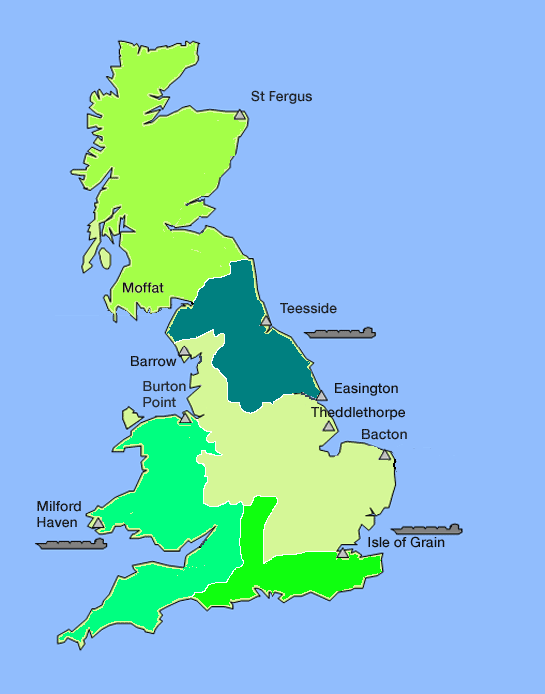
1. Introduction to Invoicing
1.2 Transportation: The National Transmission System
Distribution Network Operators
Wales & West Utilities
Southern Gas Networks
Cadent
Northern Gas Networks
Scotland Gas Networks
Terminal
Terminal/ Interconnector
Producers and importers deliver gas to the UK via;
  7 gas reception terminals
  3 Liquefied Natural Gas (LNG) importation terminals
  3 Interconnectors connecting Great Britain via undersea pipes with Belgium, Netherlands and Ireland
Gas is treated and enters the National Transmission System (NTS) which is a vast network containing approximately 7,660km of high pressure pipe
The NTS is owned and operated by National Grid, under the direction of the UNC and scrutiny of Ofgem
Gas is off taken directly from the NTS or transported to the 13 Local Distribution Zones (LDZs) where it enters a Distribution Network (DN) from which end consumers are supplied
There are 8 regional DNs controlled by 5 Distribution Network Operators (DNO) as shown on the map
https://www.nationalgrid.com/uk/about-grid/our-role-industry/about-gas

Slide 6
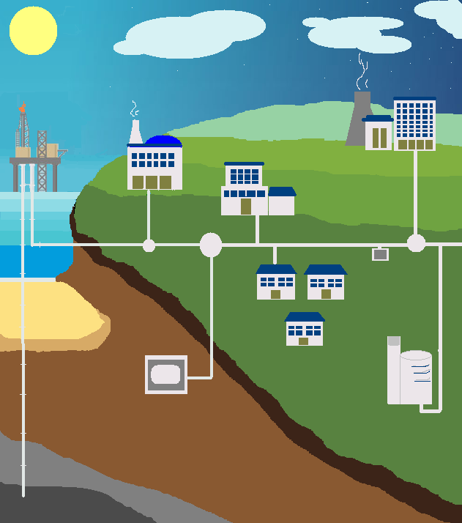

1. Introduction to Invoicing
1.3 Infrastructure Map
The map summarises (at a very high level) the UK gas transportation infrastructure
The primary users of the National Transmission System (NTS) are Shippers transporting gas from terminals to the Local Distribution Networks (LDZs) in order to provide suppliers and end consumers with gas.
There are a number of NTS connections which offtake gas directly from the NTS, these are typically large Daily Metered (DM) sites
Use of the NTS and LDZ is not free and charges are applied for different sections of the network, all of which have multiple dependencies
Producers pipe gas to the shore
National Grid receives gas at the Terminals
Non Standard Sites
Pressure reduction station
LDZ offtakes
Compressor
Storage
LNG Storage
NTS
LDZ

Slide 7
1. Introduction to Invoicing
1.4 Invoicing Principles
Gas is transported from the terminal through the NTS and LDZ network to the supply meter point. There are charges which relate to the various aspects of the supply and delivery of gas.
Invoices can broadly be split into two categories;
NTS Gemini Invoices – Charges calculated directly in Gemini
Transportation Invoices – Charges calculated directly in UKLink
Invoices are generated based upon scheduled invoice dates which can be viewed via the Xoserve Billing Calendar, which is published annually on Xoserve.com
Further details of the invoices and charges are outlined in section 3.

Slide 8
1. Introduction to Invoicing
1.5 Introduction to Charges and Invoices
Transportation Invoices are all sent as a generic invoice file (.INV) via the IX Network.
Transportation Invoices are categorised as:
Core Invoices: The three core invoices are; LDZ Capacity, Commodity and Amendments
Scheduled Ancillary Invoices: Ad-hoc invoices issued on specific days. For example; Meter Asset, DNI, Compression and Failure to Supply Gas
Unscheduled Ancillary Invoices: Ad-hoc invoices issued on request. For example; Request to Bill and Site Visit
Charges
Charges
Charges
Charges
Core
Invoices
.INV
Scheduled
Ancillary
Invoice
.INV
Unscheduled
Ancillary
Invoice
.INV
Gemini
Invoices
IX
Gemini Energy Balancing Invoices are sent via the IX and do not follow a generic format. There are 7 types of Gemini Invoice and the invoices Shippers receive depend upon their activities and portfolio.
Shipper
Invoice files are explained in further detail in Section 2

Slide 9
1. Introduction to Invoicing
1.6 Charge Concepts
Invoices are made up of numerous charges, calculated by various factors which differ from charge type to charge type
All rates are assessed annually by the NWOs and published in the Transportation Charges Statements on www.gasgovernance.co.uk
The complete list of invoice types mapped to charge types can be found in the Xoserve Comprehensive Invoices and Charge Types and is available here
The table to the right is an example of all charges which can appear on the ‘COM –Core Commodity Invoice’
  Some charges will always be included
  Other charges are only included if applicable to the site configuration and the Shipper’s portfolio (i.e. Domestic only or includes IGT, Non Standard or Commercial sites) .
Charges for each invoice are explained in further detail in Section 2
Notes:
www.gasgovernance.co.uk is the Joint Office of Gas Transporters website

Slide 10
2. Invoice File Overview

Slide 11
2. Invoice File Overview
2.1 Introduction
Invoices are issued to Shippers as electronic files over the IX network. The files are formatted as comma separated values (CSV) using industry agreed formats.
Additional files containing lower level detail are also provided to support the invoices. These are known as supporting information files.
Each invoice and supporting information file follows an agreed file hierarchy, with specific file records which align to an agreed file format.
The Xoserve Comprehensive Invoices and Charge Types document defines which Supporting Information files are available against each Invoice Type.
The following section outlines the invoice and supporting information files in further detail.

Slide 12
2. Invoice File Overview
2.2 File Format Principles – Transportation Invoices
.INV
The invoice file contains charge types and charge values
Generic Invoice file .INV for all invoice types
Transportation Invoice
Supporting Information (1st level)
Supporting Information file accompanying the .INV
Charge information at SMP level for Class 1 & 2 sites
Charge information for Class 3 & 4 sites at aggregated level (Core invoices only)
Supporting Information (2nd level)
Only applicable to Core invoices
Additional Supporting Information providing charge information at SMP level for Class 3 & 4 sites

Slide 13
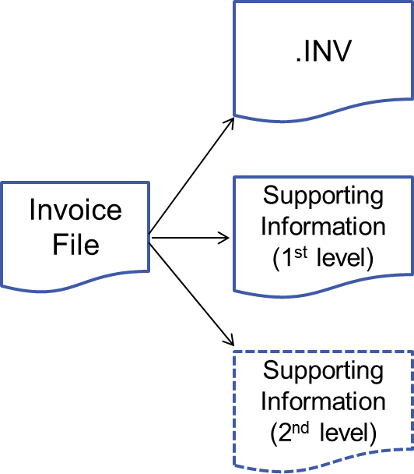


2.2 File Format Principles – Transportation Invoices
2.2.1 Supporting Information Files
Thin Files are the 1st level of Supporting Information
  Mandatory to accompany Core Invoices (CAZ, COM and AMS)
  Sent with some Ancillary Invoices
  Automatically sent in a separate file and on same day as the .INV
  Delivered via the IX
Thick Files are the 2nd level of Supporting Information
  Not mandatory and only available for Core Invoices (CAZ, COM and AMS)
  Thick Files are delivered via the IX at a later date following invoice generation within agreed timescales
  Available on Shipper request by completing the Request for Additional Supporting Information Template and files will be sent for future dates. Please note, retrospective requests for data is not available as standard.
  Exceptional request may be discussed with the Xoserve Commercial Team via commercial.enquiries@xoserve.com (please include exact details of information required)

Slide 14
2.2 File Format Principles – Transportation Invoices
2.2.2 Supporting Information Level 1 and 2
The table below maps the Supporting Information level 1 and level 2 to the core Transportation Invoices;
Core Invoice | Invoice | Supporting Information 1st Level | Supporting Information 2nd Level
COM | Commodity | COM | COI
CAZ | Capacity | ZCS | CZI
AMS | Amendment | ASP | AML

Slide 15
2. Invoice File Overview
2.3 File Format Principles – NTS Gemini Invoices
Gemini invoices do not follow a generic invoice file format as the Transportation Invoices do
Each Gemini invoice has their own industry agreed file format and hierarchy
Supporting Information is embedded into the invoice file, so there is not a separate supporting information file
For example, the Energy Balancing Invoice (.IDB) includes the Supporting Information within the same CSV invoice file
Gemini File Formats can be found here
  UK Link Documentation Library > UK Link Interface Documents > 3b. User Interface Documents > Gemini > Gemini File Formats
To gain access to the Xoserve site where the file formats are held, please complete and submit a Secure Site Access Request Form. You will need an Office 365 account as documents are stored on SharePoint Online.
Notes:
Invoice and Supporting Information within same file – ECO / NTE / NXC / IDB (BAL)
Path detailed within I57 record on the invoice – ADE
RTB invoices from SAP so different supporting info file – OWG (OSG) and CPN (NSC)

Slide 16
2. Invoice File Overview
2.4 Generic Invoice File (.INV) Hierarchy
The hierarchy is formatted into three levels. Each invoice file is made up of 7 mandatory records and 1 optional record. For support with reading the files, please refer to the INV_Generic_Invoice File Format document (see next slide for location on Xoserve.com).
HD_A00_STANDARD_HEADER
RT_I59_INVOICE_ITEM_DETAIL
RT_I57_ANCILLARY_INV_SUPP_INFO
This record is optional (all others are mandatory
Generic Invoice
RT_I56_INVOICE_DETAIL
RT_I05_INVOICE_CLAUSE
TR_Z99_STANDARD_TRAILER
RT_I58_INVOICE_REMITTANCE
RT_I60_INVOICE_REMIT_DETAIL

Slide 17
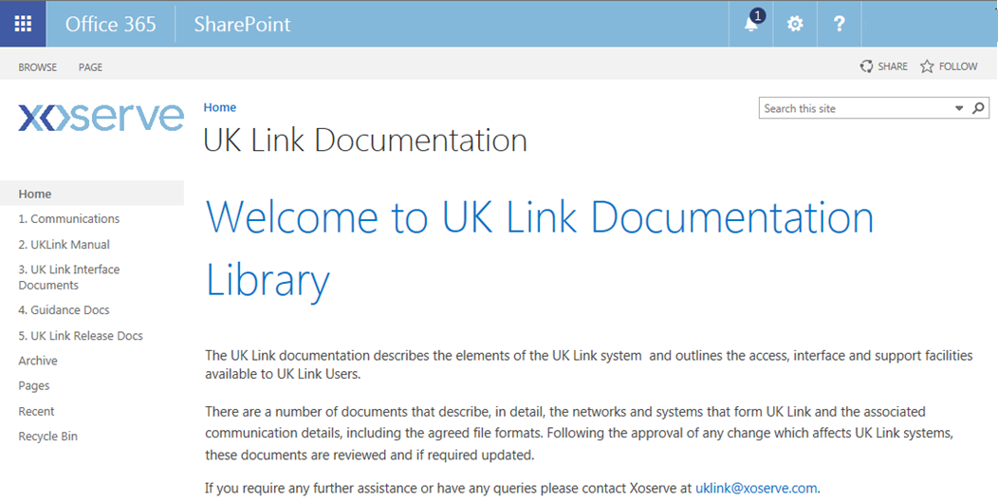
2.4 Generic Invoice File (.INV) Hierarchy
2.4.1 .INV File Hierarchy and File Format
The UK Link Documentation Library on Xoserve.com provides the .INV file format hierarchy and file format
File Hierarchy can be found here
UK Link Documentation Library > UK Link Interface Documents > 3b. User Interface Documents > Shipper > File Hierarchies > INV File Hierarchy
File Format can be found here
UK Link Documentation Library > UK Link Interface Documents > 3b. User Interface Documents > Shipper > File Formats > INV_Generic_Invoice

Slide 18
2. Invoice File Overview
2.5 Supporting Information File Hierarchy (COM)
As per the .INV file, supporting information files follow a hierarchy. As an example, the Core Commodity Invoice Supporting Information (.COM) is shown below and is formatted into 4 levels. For support with reading the files, please refer to the relevant File Format document (see next slide for location on Xoserve.com).
These records are optional (all others are mandatory
RT_J30_ENERGY_SUMMARY_DETAIL_CLASS1
HD_A00_STANDARD_HEADER
RT_K78_COMM_INVOICE_DETAIL_CLASS_1_AND_2
Core Commodity Invoice Supporting Information
RT_Q28_STANDARD_INVOICE_SUMMARY
RT_K42_STANDARD_CORE_INVOICE_ITEM_SUMMARY
RT_K79_COMM_INV_AGGREGATE_DETAIL_CLASS_3_AND_4
TR_Z99_STANDARD_TRAILER
RT_R15_DAILY_LDZ_ENTRY_ COMM_CHARGE

Slide 19
2. Invoice File Overview
2.5 Supporting Information File Hierarchy (CAZ)
As per the .INV file, supporting information files follow a hierarchy. As an example, the Capacity Invoice Supporting Information (.CAZ) is shown below and is formatted into 3 levels. For support with reading the files, please refer to the relevant File Format document (see next slide for location on Xoserve.com).
RT_K80_CAP_INV_DETAIL_CLASS_1
_AND_2
These records are optional (all others are mandatory
HD_A00_STANDARD_HEADER
RT_K81_CAP_INV_AGGREGATE_
DETAIL_CLASS_3_AND_4
Core Capacity Invoice Supporting Information
RT_Q28_STANDARD_INVOICE_SUMMARY
RT_K42_STANDARD_CORE_INVOICE_ITEM_SUMMARY
RT_I09_CAP_RATCHET_CHARGE_
DETAIL
RT_K71_CAP_SEASONAL_CAPACITY_FAILURE_CHARGE
TR_Z99_STANDARD_TRAILER
RT_K54_CAP_ADMIN_CHARGE_
DETAIL

Slide 20
2.5 Supporting Information File Hierarchy
2.5.1 Supporting Information File Hierarchies and File Formats
The UK Link Documentation Library on Xoserve.com provides the file format hierarchies and file formats for each type of Supporting Information
File Hierarchies can be found here
UK Link Documentation Library > UK Link Interface Documents > 3b. User Interface Documents > Shipper > File Hierarchies (then look for the relevant Supporting Information File)
File Formats can be found here
UK Link Documentation Library > UK Link Interface Documents > 3b. User Interface Documents > Shipper > File Formats (then look for the relevant Supporting Information File)

Slide 21
3. Invoices and Charges

Slide 22
3. Invoices and Charges
3.1 Introduction
As previously stated Invoices can be separated into 3 categories; Core, Ancillary Scheduled and Ancillary Unscheduled.
The majority of charges are VAT applicable, some are VAT exempt and others have VAT applied at 0%. As a general rule, the prevailing VAT rate is charged for Transportation Charges (TPN) and at 0% for Energy Charges (ENG).
Whilst the charges are VAT applicable some shippers are not registered in the UK and therefore will pay the relevant taxes appropriate to their country of registration
The majority of the Invoices are scheduled and released in line with Section S of Uniform Network Code in a controlled and predictable manner.

Slide 23

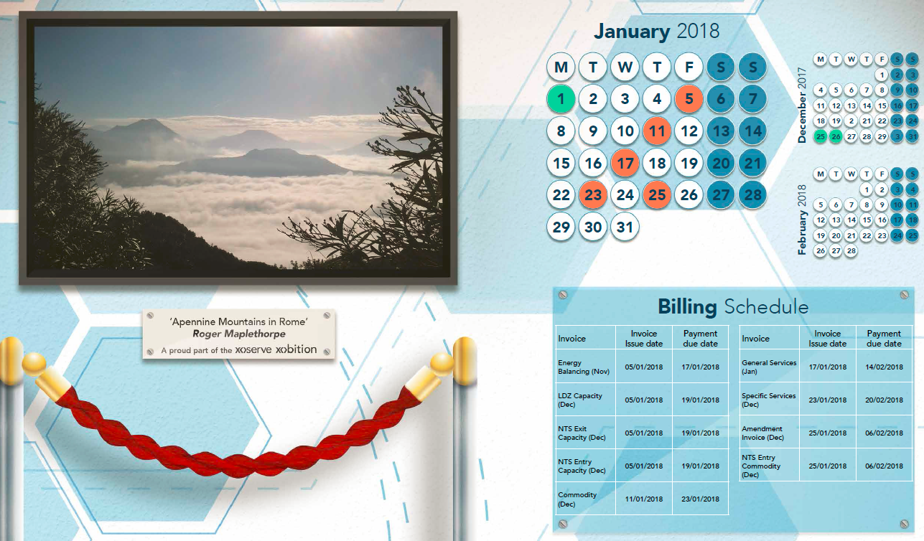
3.1 Introduction
3.1.1 Xoserve Billing Calendar
The Invoice Schedule is shared with the industry on a published billing calendar
The calendar details the invoices due to be issued within the month, along with the payment due date
Invoices are scheduled on a specific calendar or business day.
A link to the Xoserve Billing Calendar is available from the Our Services > Operations page on Xoserve.com

Slide 24
3.1 Introduction
3.1.2 Invoicing Timeline
The timeline below indicates which Calendar Day (CD) or Business Day (BD) the scheduled invoices are issued. This pattern is repeated monthly.
LIA
FSG
FSG
1, 2 or 3
12
27
CD
BD
4
7
8
11
12
15
18
19
20
23
INT - 3rd to last BD of the month
EOI
ADP
MAS
ADI
CPN
CAZ
NXC
NTE
AMS
ECO
ADE
BAL
COM
OWG
PNS
UPI
OTA
Refer to section 3.2 for invoice short codes definitions

Slide 25
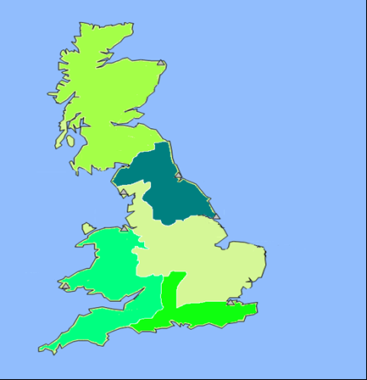
3.2 Overview of Invoices and Charges
3.2.1 Networks and Shippers
Distribution Network Operators
Wales & West Utilities GT5
Southern Gas Networks GT4
Cadent (Formally National Grid) TGT
Northern Gas Networks GT3
Scotland Gas Networks GT2
Core Invoices along with others are created at Shipper/Network level and potentially each Shipper could receive multiple each invoice type each month
The map shows the different geographical Network locations, along with an example of potential sites for 3 Shippers
A shipper would only receive a core invoice if they had a portfolio with sites in a specific network.

Slide 26
3.2 Overview of Invoices and Charges
3.2.2 Calculations Overview
Invoices are made up of various charges and at a very high level charges can be split into two groups, those driven by usage and those driven by events.
The billing quantity is calculated in kwh as a quantity and can be calculated using the Supply Offtake Quantity (SOQ=The maximum daily consumption for a supply point) x number of days in that billing period, or the billing quantity is determined as an energy by Gemini and invoiced accordingly. Energy can be calculated from the meter read shown next.
Billing Quantity x Rate
Therefore, the charge is calculated by either:
OR
Occurrence x Rate

Slide 27
3.2 Overview of Invoices and Charges
3.2.3 Calculating energy from reads
To calculate energy usage you require two reads (volume) and work out the the difference. Then convert this volume to energy (kwh) following the below steps.
*If your imperial meter measures in cubic feet rather than hundreds of cubic feet, you’ll need to use 0.0283 for step 2 rather than 2.83. If it uses thousands of cubic feet, you’ll need to use 28.3 instead. Your meter will usually say ‘x100’ or ‘x1000’
**The correction factor (typically 1.02264 ) is used to take into account the temperature, pressure and atmospheric conditions at a site. If a site has a corrector the read will have this calculated already.
***The calorific value (CV) is a measurement of the amount of energy contained in gas, measured in megajoules per cubic meter (MJ/m cubed). The CV of the gas at each LDZ is continually measured by National Grid, who publish the figures. Typically, a gas supply has a CV between 37.5 and 43.0 MJ/m cubed.
If imperial covert to metric by multiplying the units by 2.83*
If meter reading multiply by volume correction factor (e.g.1.02264)**
Multiply by calorific value (e.g.40.0)***
Divide by kwh conversion factor 3.6

Slide 28
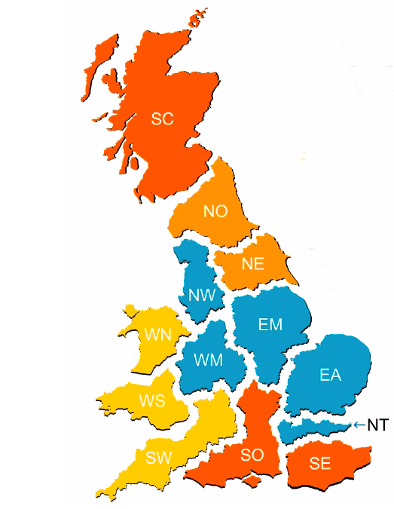
3.2 Overview of Invoices and Charges
3.2.4 Prices and Rates
Prices or rates are determined by a number of factors.
For standard sites, prices are set by the Networks and will differ depending on location and usage of the site.
Each year the new rates are published in the charge-
  charging statements per LDZ and AQ band
  (when appropriate)
All rates are published in the transportation charges statements www.gasgovernance.co.uk
For Non Standard Sites the rates/prices are agreed between Shipper and Network.
LDZ
MAP
 | AQ to | AQ From
Band | 0 | <73,200
 | 73,200 | <732,000
 | 732,000 | +

Slide 29
3.2 Overview of Invoices and Charges
3.2.5 Charges Overview
Each rate is associated with a charge and invoices are made up of multiple charges
There are approximately 350 charges in total
Charges are identified by a 3 digit reference
The majority of these charges are only applied for specific site types, for example;
  Non Standard Sites*
  Sites on an IGT*
  Class 1&2 Sites*
  Seasonal Large Supply Meter Points (SLSMP)*
These charges are listed against each invoice in the Xoserve Comprehensive Invoices and Charge Types and is available here.
*see Appendix for definitions

Slide 30
3.2 Overview of Invoices and Charges
3.2.6 Xoserve Contact Matrix
This table provides the various Xoserve email addresses for invoicing requests and queries
Invoice | Xoserve Contact
Capacity & Commodity | capcom@xoserve.com
FSG | ric.fsgcompensation@xoserve.com
Invoicing queries | xoserve.invoicing@xoserve.com
Amendments | recandrbd.billing@xoserve.com
Prime & Sub | primesubs.pgt.cpm@xoserve.com
Duplicates | copyinvoice.billingoperations@xoserve.com
Energy Balancing | ebi.billing@xoserve.com
NTS Capacity | rgtainvoicing.im@xoserve.com
Ancillary Billing | adhoc.billing@xoserve.com

Slide 31
3.3 Summary of Invoice Types
3.3.1 Core Invoices
The following section aims to;
  Summarise all invoices under the three main categories, including the VAT and Scheduled Dates.
  Provide a high level description of each individual invoice
  Provide a high level overview of all charges which could appear within each invoice
Invoice Type | Invoice short code | Invoice Name
Core Invoices | CAZ | Core Capacity Invoice
 | COM | Core Commodity Invoice
 | AMS | Core Amendment Invoice
For further details on the charges which appear in the Scheduled and Unscheduled invoices, refer to the Xoserve Comprehensive Invoices and Charge Types.

Slide 32
3.3 Summary of Invoice Types
3.3.2 Scheduled Ancillary Invoices
Invoice Type | Invoice short code | Invoice Name
Scheduled Ancillary Invoices | NTE | NTS Entry Capacity Invoice
 | NXC | NTS Exit Flat Capacity Invoice
 | ECO | NTS Entry Commodity Invoice
 | OWG | Own Use Gas (Exit Commodity) Invoice
 | BAL | Energy Balancing Invoices
 | OTA | Optional Tariff Invoice
 | CPN | Compression Invoice
 | LIA | Service Standard Liabilities Invoice
 | EOI | DN Interrupt Option and Exercise Fee
 | FSG | Failure To Supply Gas Invoice
 | PNS | Prime And Subs Invoice
 | MAS | Meter Asset Charges Invoice
 | ADP | Meter Reading Data Logger Charges Invoice
 | INT | Interest On Adjustments Invoice
These invoices are primarily calculated by:
Billing Quantity x Rate
The Billing quantity is determined by Gemini and thus these invoices are often referred to as Gemini Invoices
The invoices are Primarily calculated based on occurrences of various factors e.g.
How many Assets on a special metering sites, number of site visits & how many liabilities have been breached etc.

Slide 33
3.3 Summary of Invoice Types
3.3.3 Unscheduled Ancillary Invoices
The remainder of the invoices are unscheduled and are issued for specific infrequent scenarios or activities.
Invoice Type | Invoice short code | Invoice Name
Unscheduled Ancillary Invoices | ADB | Energy Reconciliation Adjustment Invoice
 | ADG | GRE Invoice
 | ADK | Contingency Invoice
 | ADR | Reconciliation Invoice
 | ANC | Ancillary Invoice
 | TSV | Transporter Site Visit Invoice
 | UPI | User Pays Type 1 Invoice

Slide 34
3.4 Core Invoices
3.4.1 CAZ
CAZ - CORE CAPACITY INVOICE
All sites with a nominated Shipper will be included on the capacity invoice every month.
The Capacity Invoice charges for booked SOQ (Supply Off-take Quantity) for class 1 & 2 sites this utilizes a rolling SOQ which is calculated each month( as long as a read is submitted). For class 2 & 3 we use a Billing SOQ which is calculated on an annual basis sometimes referred to as formula year.
The Supply Meter Points (SMPs) are charged for the full daily SOQ, although the completed booked capacity might not be utilised. These charges are billed in the similar way for all types of SMPs using Daily SOQ values x Days in the billed period (Billing Quantity) x Rate.
If a Class 1 or 2 SMP exceeds its Daily Metered Supply Off-take Quantity (DMSOQ) during the live ratchet period then a ratchet charge is applied and will be issued on Month +2 after the Ratchet was incurred.
The .INV file is aggregates these charges at Shipper/Network level.
VAT applicable Issued on 4th Business Day

Slide 35
3.4.1 Core Invoices - CAZ
3.4.1.1 Capacity (CAZ) Charges
Taken from the Xoserve Comprehensive Invoices and Charge Types Sheet, the Commodity charges are identified and the site types they apply to.
CAZ - CORE CAPACITY INVOICE
Charge | Charge Description | Comment
SCF | SEASONAL CAPACITY FAILURE CHARGE | SLSMP Only
871 | UNIQUE - LDZ CAPACITY CHARGE | Non Standard Sites only
872 | UNIQUE - CUST CAPACITY CHARGE | Non Standard Sites only
881 | LDZ OPTIONAL TARIFF | Non Standard Sites only
884 | ADMINISTRATION CHARGE - NTS | Non Standard Sites only
901 | UNIQUE - EXIT CAPACITY LDZ ECN CHARGE | Non Standard Sites only
891 | CSEPS - LDZ CAPACITY CHARGE | IGT / CSO Sites only
894 | NDM CSEPS - ADMINISTRATION CHARGES | IGT / CSO Sites only
C04 | CSEPS - EXIT CAPACITY LDZ ECN CHARGE | IGT / CSO Sites only
SRA | SOQ RATCHET CHARGE | Class1&2 sites only
883 | DM ADMINISTRATION CHARGE LDZ | Class1&2 sites only
ZRA | CUSTOMER RATCHET CHARGE | Class1&2 sites only
CCA | CUSTOMER CAPACITY CHARGE | Standard Charge
CFI | CUSTOMER FIXED CHARGE | Standard Charge
ZCA | SUPPLY POINT CAPACITY CHARGE | Standard Charge
ECN | EXIT CAPACITY LDZ ECN CHARGE | Standard Charge
These charges are only relevant for Non Standard Sites i.e. IGT, CSO, Shorthaul Direct connect etc
Ratchets are only charged when a class 1 or 2 site offtakes too much gas over the winter period
A Shipper with a portfolio only containing standard SMPs will only see the 4 standard capacity charges on their CAZ invoice
The charges in red are described in further detail on the next slide

Slide 36
3.4.1 Core Invoices - CAZ
3.4.1.2 CCA, ZCA, ECN, CFI Standard Charges (How it is calculated)
These are calculated using Supply Offtake Quantity x number of days in that billing period, x Rate as follows : -
(The below calculation is based on an SOQ of 313 with example rates taken from the published Transportation Charges Booklets for a 31 day month)
ZCA Charge = 313 (SOQ) * 0.1987 (Rate) * 31 (No. of days) / 100 = £19.28
CCA Charge = 313 (SOQ) * 0.1061 (Rate) * 31 (No. of days) / 100 = £10.29
ECN Charge =313 (SOQ) * 0.0076 (Rate) * 31 (No. of days) / 100 = £0.74
CFI Charge
This charge is a fixed charge per day and only applies to supply meter points with an AQ between 73,200 and 732,000 kWh. Sometimes referred to as a Large Supply Point (LSP)

Slide 37
3.4.1 Core Invoices - CAZ
3.4.1.3 File Examples for LDZ Transportation (CAZ)
This example demonstrates how the two levels of Supporting Information relate back to the Invoice. A similar structure can be applied to the other Core Invoices (COM and AMS).
File | File description | Comments
 | .INV Invoice File for CAZ (csv file) | Invoices are generated per Shipper at Network level. In this example, it is for a single Shipper (“SHP” in this file but this would be the actual Shipper Short Code) for the GT2 Network.
 | ZCS Supporting Level 1 (csv file has already been delimited in this example) | Supporting information for all Networks “SHP” operates in. In this example, it covers all 5 Networks. Class 1 & 2 – SMP level (n/a as Shipper only has a DOM portfolio) Class 3 & 4 – Aggregated from SMP charges
 | CZI Supporting Level 2 (csv file has already been delimited in this example) | Additional Supporting Information file that is available for Shippers to view information at the SMP level for Class 3 & 4 Reminder: This information is available upon request only.
The files are based on real data but information has been masked for Data Protection purposes and naming convention will always be in a 5.8.3 format

Slide 38
3.4 Core Invoices
3.4.2 COM
COM - CORE COMMODITY INVOICE
The Commodity Invoice contains charges for the transportation of gas (kWh) through both the NTS and LDZ system. Like the Capacity invoice, the Commodity Invoice is calculated by using Billing Quantity and Rate. However the Billing Quantity has an energy factor applied which takes into consideration a number of elements which will make Billing Quantity higher or lower depending on the impacting elements.
Every site will be subject to a commodity charge every month and this is calculated by individual MPRN (SMP).
LSEC charges which credit shipper for flowing gas onto the network for Bio Methane sites are also issued on the commodity Invoice
As a result of National Grid sale of its Gas Distribution operations in 2017, the Distribution Network and National Transmission systems being operated by separate companies; Cadent and National Grid Transmission. UK Link does not currently support the separation of these charges so an interim solution is currently in place. The Commodity Invoice for Cadent will be issued with the charges for NTS and LDZ. Xoserve will manually credit the NTS charges on this invoice. A separate invoice will be issued on behalf of National Grid Transmission for the NTS charges. See Appendix 4.1 for more information.
VAT applicable Issued on 8th Business Day

Slide 39
3.4.2 Core Invoices - COM
3.4.2.1 Commodity (COM) Charges
Taken from the Xoserve Comprehensive Invoices and Charge Types Sheet, the Commodity charges are identified and the site types they apply to.
COM - CORE COMMODITY INVOICE
Charge | Charge Description | Comment
ZCO | LDZ COMMODITY CHARGE | Standard Charge
NCO | NTS EXIT COMMODITY CHARGE | Standard Charge
NCS | NTS SO EXIT COMMODITY CHARGE | Standard Charge
NCT | NTS TO EXIT COMMODITY CHARGE | Standard Charge
878 | UNIQUE - LDZ COMMODITY | Non Standard Sites only
877 | UNIQUE-NTS EXIT Commodity | Non Standard Sites only
87T | UNIQUE-NTS TO EXIT COMMODITY | Non Standard Sites only
87S | UNIQUE-NTS SO EXIT COMMODITY | Non Standard Sites only
880 | UNIQUE NTS COMMODITY SHORTHAUL | Non Standard Sites only
893 | CSEPS - LDZ COMMODTY CHARGE | IGT/CSO Sites only
892 | CSEPS- NTS EXIT COMM CHARGE | IGT/CSO Sites only
89T | CSEPS- NTS TO EXIT COMM CHARGE | IGT/CSO Sites only
89S | CSEPS- NTS SO EXIT COMM CHARGE | IGT/CSO Sites only
LEC | LDZ SYSTEM ENTRY COMMODITY CHARGE | Standard Charge
LEA | LDZ SYSTEM ENTRY COMMODITY CHARGE ADJ | Standard Charge
A Shipper with a portfolio only containing standard SMPs will only see the standard commodity charges on their COM invoice.
The other charges are present for non-standard sites i.e. IGT, CSO, Shorthaul Direct connect etc
Charges for Non-standard Sites only (replace standard charges)
Charges for IGT/CSO only (replace standard charges)
LSEC charges for Bio methane sites.
The charges in red are described in further detail on the next slide

Slide 40
3.4.2 Core Invoices - COM
3.4.2.2 ZCO Charge for class 4 sites (How it is calculated)
Class 4 sites are calculated based on deemed energy. Energy factors* are used to calculate this as follows:
Billing Quantity = Energy Factor Last day of Current Month - Energy Factor Last day of Previous Month x AQ ROLL 10
Therefore as an example
If the Energy Factor for Gas Flow Day 30th June 2017 is 9.15088593297741
And The Energy Factor for Gas Flow Day 31st July 2017 is 9.38953643703708
The rolling AQ for the period 01.07.2017 to 31.07.2017 is 39589.
(9.38953643703708 - 9.15088593297741) * 39589 = 944.79348052 kwh
10
You would then multiply this by the rates published in the appropriate Transportation Charges Booklet
*Energy factors are detailed in the daily LPA files you receive via the IX.

Slide 41
3.4.2 Core Invoices - COM
3.4.2.3 880 Unique NTS Commodity Shorthaul (How it is calculated)
The NTS Optional Commodity Charge is calculated using the following formula
  Where D is the direct distance of the site or non National Grid NTS, to the elected Entry Terminal.
  M is the MNEPOR at the site which is agreed by the s, converted into kWh/day
  ^ is ‘to the power of’
p/kWh = (1203 x M ^-0.834 x D) + (363 x M ^-0.654)
Therefore is we assume a distance of 15km from terminal and an MNEPOR of 313
=(1203 x (313^-0.834)x15) + (363x(313^-0.645))
=(149.649)+(8.46776)
=158.117pence per kwh (£1.58)

Slide 42
3.4 Core Invoices
3.4.3 AMS
AMS - CORE AMENDMENT
The Amendment Invoice is made up of a variety of elements.
The primary trigger for class 3&4 sites is receipt of check reads for a site and, whereby the commodity essentially estimated the gas used, with this read provided the exact gas and the difference can be calculated and charged.
Also other Ancillary Invoices have been sent previously using estimated energies, these will now be reconciled using the actual energy to calculate.
Another part of this invoice is the charge to redistribute the unidentified gas (UiG) throughout the network and across all shipper networks proportionally to their portfolio (see later slide)
The AMS invoice also allows for any other adjustment to be made and charged. For example, a previously charged ratchet may have been challenged successfully and the additional charges credited.
VAT applicable Issued on 18th Business Day

Slide 43
3.4.3 Core Invoices - AMS
3.4.3.1 Amendments (AMS)
Taken from the Xoserve Comprehensive Invoices and Charge Types Sheet, the AMS charges are identified by relevance to site type.
AMS - CORE AMENDMENTS
Charge | Charge Description | Comment
ZRE | LDZ COMMODITY RECONCILIATION | Standard Charge
GRE | GAS VARIABLE RECONCILIATION | Standard Charge
NRE | NTS EXIT COMM RECONCILIATION | Standard Charge
CRC | CAPACITY RECONCILIATION CHARGE | Standard Charge
CRA | CAPACITY RECONCILIATION CHARGE ADJ | Standard Charge
UGR | UNIDENTIFIED GAS RECONCILIATION ENERGY | Standard Charge
AMC | CUSTOMER CAPACITY CHARGE ADJ | Standard Charge
AMZ | SUPPLY POINT CAPACITY CHARGE ADJ | Standard Charge
AMF | CUSTOMER FIXED CHARGE ADJ | Standard Charge
AME | EXIT CAPACITY LDZ ECN CHARGE ADJ | Standard Charge
83A | ADMINISTRATION CHARGE LDZ ADJ | Standard Charge
84A | ADMINISTRATION CHARGE NTS ADJ | Standard Charge
SRD | SOQ RATCHET CHARGE ADJ | Class1&2 sites only
ZRD | CUSTOMER RATCHET CHARGE ADJ | Class1&2 sites only
SCD | SEASONAL CAPACITY FAILURE CHARGE ADJ | SLSMP Only
A Shipper with a portfolio only having standard SMPs will only see the 12 standard Amendment charges on their AMS invoice.
Ratchets occur on class 1&2 sites and adjustments occur when the original ratchet is amended or challenged
The charges in red are described in further detail on the next slide

Slide 44
3.4.3 Core Invoices - AMS
3.4.3.2 ZRE Charge for class 4 sites (How it is calculated)
Reconciliation occurs on a Class 3 & 4 sites when a check read is received. After close out and at a high level it uses the new check read, calculates back to the previous check read to determine actual energy and the calculates the difference between the actual and deemed energies. Class 1&2 only require reconciliation when there has been estimated reads entered or a drift has been noted on a site visit.
If we assume the energy used to calculate LDZ commodity charge for last month was 944.79348052 kwh
based on Energy factors and AQ roll.
We have now received check reads for the start and end of the that month and can calculate actual energy.
Again assume actual energy calculated is 950kwh and a rate of 0.0698
The difference between the two, multiplied by the rate would be the ZRE charge for that site (can be credit)
950-944.79348052 x 0.698/100= £0.04
5.20651948 x 0.698/100 = £0.04

Slide 45
3.4.3 Core Invoices - AMS
3.4.3.3 UGR Charge (How it is calculated)
UiG Allocation Process
After the Gas Day Allocation
The gas is allocated to daily metered Supply Points based on actual measurements.
An estimate for Non Daily Metered points is calculated based upon AQ and weather
The remaining gas is unidentified gas
The unidentified gas (energy) is shared to all Shippers equally in proportion to the Shipper’s portfolio. This is sent at LDZ level also using throughput as one of its parameters.
Charges are issued on the AMS invoice on the UGR charge type
The UiG allocation will be visible in Gemini.
Shrinkage
Unidentified Gas
remaining
energy is
smeared at
LDZ Portfolio
Level
Actual
Measurements
From Daily
Reads
Daily
Metered
Non-Daily
Metered
Improved
Standalone
Estimation
for NDM
Sector
(Class 3 & 4)
LDZ Total
Energy Forecast
Unidentified Gas = (shared at LDZ & Shipper portfolio level based on throughput, not AQ) | Total LDZ Forecast
 | Minus | Shrinkage
 | Minus | DM Usage
 | Minus | NDM Estimate Usage

Slide 46
3.4.3 Core Invoices - AMS
3.4.3.4 Core Invoice Charge Mapping Amendments (AMS)
Taken from the Xoserve Comprehensive Invoices and Charge Types Sheet, the AMS charges are identified by relevance to site type.
AMS - CORE AMENDMENTS
Charge | Charge Description | Comment
S15 | CSEP AGG REC NTS TRANS CHG ANN SHR ADJ
916 | CSEP AGG REC LDZ TRANS CHG ADJ | IGT/CSO Sites only
926 | CSEP AGG REC CLEARING VALUE | IGT/CSO Sites only
S16 | CSEP AGG REC LDZ TRANS CHG ANN SHR ADJ | IGT/CSO Sites only
S26 | CSEP AGG REC CLEARING VALUE ANN SHR | IGT/CSO Sites only
ACZ | CSEPS - LDZ CAPACITY CHARGE ADJ | IGT/CSO Sites only
ACE | CSEPS - EXIT CAPACITY LDZ ECN CHARGE ADJ | IGT/CSO Sites only
895 | CSEPS - ADMINISTRATION CHARGES ADJ | IGT/CSO Sites only
ACY | CSEPS - LDZ COMMODITY RECONCILIATION | IGT/CSO Sites only
ACT | CSEPS - NTS TO EXIT COMMODITY RECONCILIATION CHARGE | IGT/CSO Sites only
ACS | CSEPS - NTS SO EXIT COMMODITY RECONCILIATION CHARGE | IGT/CSO Sites only
915 | CSEP AGG REC NTS TRANS CHG ADJ | IGT/CSO Sites only
ACN | CSEP - NTS EXIT COMM RECONCILIATION | IGT/CSO Sites only
These CSEP Charges are only appropriate for shippers with IGT or CSO sites in their portfolio .

Slide 47
3.4.3 Core Invoices - AMS
3.4.3.5 Core Invoice Charge Mapping Amendments (AMS)
Charge | Charge Description | Comment
S22 | USER AGG REC CLEARING VALUE ANN SHR
917 | USER AGG REC NTS TRANS CHG ADJ
918 | USER AGG REC LDZ TRANS CHG ADJ
922 | USER AGG REC CLEARING VALUE
S17 | USER AGG REC NTS TRANS CHG ANN SHR ADJ
S18 | USER AGG REC LDZ TRANS CHG ANN SHR ADJ
AUA | UNIQUE - CUST CAPACITY CHARGE ADJ | Non Standard Sites only
AUZ | UNIQUE - LDZ CAPACITY CHARGE ADJ | Non Standard Sites only
AUE | UNIQUE - EXIT CAPACITY LDZ ECN CHARGE ADJ | Non Standard Sites only
88A | UNIQUE NTS COMMODITY SHORTHAUL ADJ | Non Standard Sites only
882 | LDZ OPTIONAL TARIFF ADJ | Non Standard Sites only
AUY | UNIQUE - LDZ COMMODITY RECONCILIATION | Non Standard Sites only
AUT | UNIQUE - NTS TO EXIT COMMODITY REC CHARGE | Non Standard Sites only
AUS | UNIQUE - NTS SO EXIT COMMODITY REC CHARGE | Non Standard Sites only
AUN | UNIQUE - NTS EXIT COMM RECONCILIATION | Non Standard Sites only
NRT | NTS TO EXIT COMMODITY RECONCILIATION CHARGE | Non Standard Sites only
NRS | NTS SO EXIT COMMODITY RECONCILIATION CHARGE | Non Standard Sites only
705 | NTS OPTIONAL COMMODITY REC | Non Standard Sites only
Taken from the Xoserve Comprehensive Invoices and Charge Types Sheet, the AMS charges are identified by relevance to site type.
A Shipper with a portfolio only containing standard SMPs not see these charges on their invoice as these are only relevant for non-standard Sites
i.e. IGT, CSO, Shorthaul Direct connect etc

Slide 48
3.4.3 Core Invoices - AMS
3.4.3.6 Core Invoice Charge Mapping Amendments (AMS)
Taken from the Xoserve Comprehensive Invoices and Charge Types Sheet, the AMS charges are identified by relevance to site type.
AMS - CORE AMENDMENTS
Charge | Charge Description | Comment
RBG | RBD GAS RECONCILIATION ENERGY | Transition only
RBN | RBD NTS EXIT COMMODITY RECONCIOLIATION CHARGE | Transition only
RBZ | RBD LDZ COMMODITY RECONCILIATION CHARGE | Transition only
RCG | RBD CSEP GAS RNCLTN ENERGY | Transition only
RCN | RBD CSEP NTS EXIT COMMODITY RECONCILIATION CHARGES | Transition only
RCZ | RBD CSEP LDZ COMMODITY RECONCILIATION CHARGES | Transition only
These 6 transitional charges are only present for a 12 month period from Project Nexus go-live and will become redundant on 01/06/2018, due to the legacy Reconciliation by the Difference (RBD) process.
As a part of Nexus the reconciliation by difference process (RBD) has been replaced by unidentified gas process shown previously (UiG).

Slide 49
3.5 Scheduled Ancillary Invoices
3.5.1 Infrastructure Map
The infrastructure can be used to define some of the Gemini Invoices
The shippers responsible for transporting gas on and off the NTS pipeline are subject to additional Capacity and Commodity Charges which are issued on the following invoices:-
  NXC - NTS EXIT FLAT CAPACITY
  NTE - NTS ENTRY CAPACITY
  ECO - NTS ENTRY COMMODITY
  OWG - OWN USE GAS (EXIT COMMODITY)
  OTA - OPTIONAL TARIFF (only with NTS Shorthaul)
  CPN - COMPRESSION INVOICE (Geographical)
Shippers with a portfolio wholly made up of LDZ sites will also not be subject to these NTS invoices.
Producers pipe gas to the shore
National Grid receives gas at the Terminals
Non Standard Sites
Pressure reduction station
LDZ offtakes
Compressor
Storage
LNG Storage
NTS
LDZ

Slide 50
3.5 Scheduled Ancillary Invoices
3.5.2 Gemini Invoicing Principles
Gas is transported from the terminal through the network to the supply point. There are NTS charges which relate to the various aspects of the supply and delivery of gas on and off the NTS network .
Shippers bid at auction to book entry capacity at a specific terminal. Auctions are available for daily, monthly or quarterly entry capacity. Shippers bid for kilowatt hours (kWh) by price. At the close of the auction successful bidders are allocated capacity in order of price from highest to lowest.
Once the gas has entered a terminal, the Shipper pays for the entrance of that gas into the NTS (Entry Capacity) and a separate Exit Capacity charge to offtake the gas. The transportation of the gas between entry and exit is the NTS Commodity charge.

Slide 51
3.5 Scheduled Ancillary Invoices
3.5.3 NXC
NXC - NTS EXIT FLAT CAPACITY
NTS Exit Capacity is the booking of space on the National Transmission System.
Where the core capacity invoice calculates the space booked on and off the LDZ networks, the entry and exit charges on the NTS Network are calculated & invoiced separately.
This is done via auctions; users bid for their capacity requirement in kwh & price p/kwh and this process allows Users to book gas on and take gas off at system NTS exit points.
There is an annual application for NTS enduring Exit Capacity & also auctions for daily capacity which are referred to as before the day auctions.
VAT applicable Issued on 4th Business Day

Slide 52
3.5.3 Scheduled Ancillary Invoices - NXC
3.5.3.1 NXC
Taken from the Xoserve Comprehensive Invoices and Charge Types Sheet
Charge | Charge Description
SUC | CMP SURRENDER CHARGES
LUC | LONG TERM USE IT OR LOSE IT CHARGE
EID | NTS EXIT (FLAT) CAPACITY IP DAILY FIRM CHARGE
EIL | NTS EXIT (FLAT) CAPACITY IP LONG TERM FIRM CHARGE
EIR | NTS EXIT (FLAT) CAPACITY IP ROLLING MONTHLY FIRM CHARGE
EIO | NTS EXIT (FLAT) CAPACITY IP SHORT TERM OFF-PEAK CHARGE
NXD | NTS EXIT DAILY FIRM
NXB | NTS EXIT DAILY FOR BUYBACK
NXO | NTS EXIT DAILY OFFPEAK
XBF | NTS EXIT FORWARD CONTRACT
NXA | NTS EXIT LONG TERM
NXF | NTS EXIT OFF TAKE FLOW RED
XBE | NTS EXIT OPTION CONTRACT EXER
XBP | NTS EXIT OPTION CONTRACT PREM
XOV | NTS EXIT OVERRUN
Charges are allocated towards the different auctions and/or different parts of the bid process

Slide 53
3.5.3 Scheduled Ancillary Invoices - NXC
3.5.3.1 NXC
Taken from the Xoserve Comprehensive Invoices and Charge Types Sheet
AMS - CORE AMENDMENTS
Charge | Charge Description
ABE | ADJUSTMENT CHARGE OF XBE
ABF | ADJUSTMENT CHARGE TO XBF
ABP | ADJUSTMENT CHARGE TO XBP
AOV | ADJUSTMENT CHARGE TO XOV
AXA | ADJUSTMENT CHARGE TO NXA
AXB | ADJUSTMENT CHARGE TO NXB
AXD | ADJUSTMENT CHARGE TO NXD
AXF | ADJUSTMENT CHARGE TO NXF
AXO | ADJUSTMENT CHARGE TO NXO
AEL | ADJUSTMENT TO NTS EXIT (FLAT) CAPACITY IP LONG TERM FIRM CHARGE
AER | ADJUSTMENT TO NTS EXIT (FLAT) CAPACITY IPROLLING MONTHLY FIRM CHARGE
AED | ADJUSTMENT TO NTS EXIT (FLAT) CAPACITY IP DAILY FIRM CHARGE
AEO | ADJUSTMENT TO NTS EXIT (FLAT) CAPACITY IP SHORT TERM OFF-PEAK CHARGE
AUC | ADJUSTMENT TO CMP SURRENDER CHARGES
ALC | ADJUSTMENT TO LONG TERM USE IT OR LOSE IT CHARGE
Adjustment charges for each of the standard charges

Slide 54
3.5 Scheduled Ancillary Invoices
3.5.4 NTE
NTE - NTS ENTRY CAPACITY
NTS Entry Capacity is the booking of space on the National Transmission System. National Grid Transmission sells System Entry Capacity at auctions where users bid for capacity.
Capacity is purchased at Aggregated System Entry points (ASEPs) e.g. Terminals & Storage points
Additional charges occur when capacity is exceeded at a specific ASEP, this is known as an overrun.
VAT applicable Issued on 4th Business Day

Slide 55
3.5.4 Scheduled Ancillary Invoices - NTE
3.5.4.1 NTE
Charge | Charge Description
BSB | BACTON SPLIT BUY CHARGE
BSS | BACTON SPLIT SELL CHARGE
DAB | CAPACITY SURRENDER
CMP | CMP SURRENDER CHARGES
DIC | DAILY INTERRUPTIBLE CAPACITY
DFC | DAILY SYSTEM ENTRY CAPACITY
IPD | IP DAILY FIRM CHARGE
IPI | IP DAILY INTERRUPTIBLE CHARGE
IPY | IP LONG TERM FIRM CHARGE
IPM | IP MONTHLY FIRM CHARGE
IPQ | IP QUARTERLY FIRM CHARGE
LTI | LONG TERM INTERRUPTIBLE CAPACITY
LTU | LONG TERM USE IT OR LOSE IT CHARGE
MEC | MONTHLY SYSTEM ENTRY CAPACITY
NVR | NEGATIVE OVERRUN CHARGE
OVR | OVERRUN CHARGE
LTC | QUARTERLY SYSTEM ENTRY CPCTY
REV | REVENUE SHARE
RMC | ROLLING MONTHLY ENTRY CAPACITY
SCI | SECTION 1 REBATE
SMC | SURRENDER MONTHLY CHARGE
Taken from the Xoserve Comprehensive Invoices and Charge Types Sheet

Slide 56
3.5.4 Scheduled Ancillary Invoices - NTE
3.5.4.2 NTE
Taken from the Xoserve Comprehensive Invoices and Charge Types Sheet
Charge | Charge Description
ABB | ADJUSTMENT TO CAPACITY SURRENDER
AEC | ADJUSTMENT TO MEC
AFC | ADJUSTMENT TO DSEC CHARGE
AID | ADJUSTMENT TO ISEC CHARGE
ALI | ADJUSTMENT LONG TERM INTERRUPTIBLE
AOR | ADJUSTMENT TO OVERRUN CHARGE
ARC | ADJUSTMENT ROLLING MONTHLY CAP
ARS | ADJUSTMENT TO REVENUE SHARE
ASI | SECTION 1 REBATE ADJUSTMENT
ASC | ADJUSTMENT TO SURRENDER CHARGE
ATC | ADJUSTMENT TO LTC
AVR | ADJUSTMENT NEGATIVE OVERRUN
APY | ADJUSTMENT TO IP LONG TERM FIRM CHARGE
APQ | ADJUSTMENT TO IP QUARTERLY FIRM CHARGE
APM | ADJUSTMENT TO IP MONTHLY FIRM CHARGE
APD | ADJUSTMENT TO IP DAILY FIRM CHARGE
API | ADJUSTMENT TO IP DAILY INTERRUPTIBLE CHARGE
AMP | ADJUSTMENT TO IP CMP SURRENDER CHARGE
ATU | ADJUSTMENT TO LONG TERM USE IT OR LOSE IT CHARGE
ABA | ADJUSTMENT TO BSB CHARGE
ABS | ADJUSTMENT CHARGE FOR BSS CHARGE
Adjustment charges for each of the standard charges

Slide 57
3.5 Scheduled Ancillary Invoices
3.5.5 ECO and OWG
ECO - NTS ENTRY COMMODITY
This energy invoice charges for entry onto the National Transmission System. This relates to the actual gas that passes through the NTS entry points. There are six charges as shown below.
VAT applicable Issued on 18th Business Day
AOC | NTS COM ENTRY REB ADJ CHG
NCE | NTS COMMODITY ENTRY CHG
ROC | NTS COM ENTRY REBATE CHG
TOR | TO COMMODITY REBATE
TAR | TO COMMODITY REBATE ADJUSTMENT
TOC | TO COMMODITY CREDIT
OWG - OWN USE GAS (EXIT COMMODITY)
This Invoice charges for offtake from the National Transmission System using Charge Code 840
VAT applicable Issued on 8th Business Day

Slide 58

3.5 Scheduled Ancillary Invoices
3.5.6 BAL
BAL - ENERGY BALANCING INVOICE
The Energy Balancing regime involves maintaining the balance between system inputs and system outputs. National Grid Transmission are responsible for the safety and security of the system. Ensuring the physical balance and not to make a profit or a loss from carrying out this activity.
Users have a financial responsibility to balance the system and there are incentive charges to help them accomplish this.
Terminals
Storage withdrawal
Trade buys
- OTC
- OCM (APX Gas)
Meters DM,NDM
Storage injection
Trade sells
- OTC
- OCM (APX Gas)
Inputs
Outputs
Mix of VAT Issued on 23rd Business Day

Slide 59
3.5 Scheduled Ancillary Invoices
3.5.6 BAL (continued …)
BAL - ENERGY BALANCING INVOICE
The calculations are made using energy by rate. Gemini is used to calculate energy using the inputs and output previous.
Primarily to adhere to UNC section F1.2 a System average price is used (SAP) . The is set Trades on the On-the-Day Commodity Market (OCM) (If no Trade action takes place on the day then SAP is calculated as an average of the previous 7 days) .
For the Cash out Charges identified previously a system marginal price is calculated (SMP)
"System Marginal Buy Price" is the greater of:
  (a) the System Average Price plus the Default System Marginal Price; and
  (b) the price in pence/kWh which is equal to the highest Balancing Action Offer Price in relation to a Market Balancing Action taken for that Day;
  "System Marginal Sell Price" is the lesser of:
  (a)the System Average Price less the Default System Marginal Price; and
  (b)the price in pence/kWh which is equal to the lowest Balancing Action Offer Price in relation to a Market Balancing Action taken for that Day

Slide 60
3.5.6 Scheduled Ancillary Invoices - BAL
3.5.6.1 BAL
Taken from the Xoserve Comprehensive Invoices and Charge Types Sheet
Charge | Charge Description
ADS | ADH SMEAR CHARGE
B73 | ADH FLEX PAYT DUE TRANSCO
B74 | ADH ENTRY SCHEDULING CHG
B75 | ADH EXIT DMA SCHEDULING CHG
B76 | ADH EXIT DMC SCHEDULING CHG
B77 | ADH BAL NEUTRALITY SMEAR
B78 | ADH NDM RECONCILIATION SMEAR
B79 | ADH TOP UP SMEAR
B82 | ADH FLEX PAYMENT DUE SHIPPER
B87 | ADH DM RECONCILIATION SMEAR
TTB | TRANSCO TRADE BUY GAS COST
B91 | TRANSCO TRADE BUY GAS COST ADJ
TTS | TRANSCO TRADE SELL GAS COST
B92 | TRANSCO TRADE SELL GAS COST ADJ
Charge | Charge Description
ESC | ENTRY SCHEDULING-DUE TR'SCO
EXS | EXIT SCHEDULING-DUE TR'SCO
FPS | FLEXIBILITY PAYMENT-DUE SHP'R
FPT | FLEXIBILITY PAYMENT-DUE T'SCO
DUT | GDE DEEMED TRADE CHARGE
B93 | INCENTIVISED NOMINATION SCH - ADJ
INS | INCENTIVISED NOMINATION SCHEME
REC | NDM/CSEP RECONCILIATION SMEAR
B90 | PHYSICAL RENOM INCEN CH ADJ
PRI | PHYSICAL RENOMINATION INCENT
TUT | TOP UP NEUTRALITY SMEAR

Slide 61
3.5.6 Scheduled Ancillary Invoices - BAL
3.5.6.2 BAL
Taken from the Xoserve Comprehensive Invoices and Charge Types Sheet
Charge | Charge Description
B96 | ADJUSTMENT TO DSR COMPENSATION PAYMENT CR DR
B95 | ADJUSTMENT TO DSR FUND IMBALANCE CHARGE CR DR
B94 | ADJUSTMENT TO GDE DEEMED TRADE CR DR
CNU | BALANCING NEUTRALITY SMEAR
DMR | DM RECONCILIATION
DXS | DMA EXIT SCHEDULING-TR'SCO
DSP | DSR COMPENSATION PAYMENT
TSS | DSR FUND IMBALANCE CHARGE
B43 | EBI INTEREST
B40 | EBI THEFT OF GAS - GAS
B44 | ENERGY LATE PAYMENT RECOVERY CHARGE - CR
B45 | ENERGY LATE PAYMENT RECOVERY CHARGE - DR
CNU Charge: As previously stated the network does not make any profit on energy balancing. However if at the end of the month the network were in credit then this would be allocated to NTS participating shippers.

Slide 62
3.5.6 Scheduled Ancillary Invoices - BAL
3.5.6.3 BAL
Taken from the Xoserve Comprehensive Invoices and Charge Types Sheet
Charge | Charge Description | Comment
B62 | ADH REC GAS CASHOUT DUE TRANSCO | Cashout Charge
B63 | ADH REC GAS CASHOUT DUE SHPPER | Cashout Charge
B71 | ADH DAILY CASHOUT DUE TRANSCO | Cashout Charge
B72 | ADH CUM CASHOUT DUE TRANSCO | Cashout Charge
B80 | ADH DAILY CASHOUT DUE SHIPPER | Cashout Charge
B81 | ADH CUM CASHOUT DUE SHIPPER | Cashout Charge
B83 | UGF EXIT CASHOUT DUE TRANSCO | Cashout Charge
B84 | UGF ENTRY CASHOUT DUE SHIPPER | Cashout Charge
B85 | CSEP CASHOUT DUE TRANSCO | Cashout Charge
B86 | CSEP CASHOUT DUE SHIPPER | Cashout Charge
CCS | CUMULATIVE CASHOUTS-DUE SHP'R | Cashout Charge
CCT | CUMULATIVE CASHOUTS-DUE T'SCO | Cashout Charge
DCS | DAILY CASHOUT (DUE SHIPPER) | Cashout Charge
DCT | DAILY CASHOUT -DUE TRANSCO | Cashout Charge

Slide 63
3.5.6 Scheduled Ancillary Invoices - BAL
3.5.6.4 File Example - NTS Gemini Invoice
The BAL Invoice is an example of a NTS Gemini Invoice
There is no separate Supporting Information file, all invoice and supporting information data is within the same file
File | File description | Comments
 | NTS Gemini Invoice for Energy Balancing (csv file has already been delimited in this example) | File Type is IDB Invoice Type is BAL
The files are based on real data but information has been masked for Data Protection purposes and naming convention will always be in a 5.8.3 format

Slide 64
3.5 Scheduled Ancillary Invoices
3.5.7 OTA and CPN
OTA - OPTIONAL TARIFF
Only sites on the NTS network which have opted for the NTS Optional Tariff receive this Invoice and charge code SHO. It is calculated by taking the difference between User Daily Quantity input and output difference multiplied by between NCO & Optional Tariff rates
VAT applicable Issued on 19th Business Day
CPN - COMPRESSION INVOICE
For shippers which have booked gas onto the network which has passed the St Fergus compressor, near Aberdeen incur additional charges due to the additional activity. Charge code 900
VAT applicable Issued on 20th Business Day

Slide 65
3.5 Scheduled Ancillary Invoices
3.5.8 LIA and FSG
LIA - SERVICE STANDARD LIABILITIES
Within Uniform Network Code (UNC) a number of performance standards are set out for class 3&4 sites. Failure to meet these standards results in liability payments to Shippers. The aggregated data is calculated to produce the liability invoices that are issues to Shippers.
There Standard Liability Charges that are entered into UKLink and are invoiced on a monthly basis on charge code is 810
VAT exempt Issued on 1st 2nd or 3rd^{th} Calendar Day
FSG - FAILURE TO SUPPLY GAS
If there is a failure with gas supply, the Network is liable to pay the Shipper (and consumer) a pre-agreed rate (compensation) for every 24 hour period of failure.
The Network Organisation records the FSG (Failure to Supply Gas) incidents at MPRN level. This is an example of Service Standard Liability however, with its own invoice with Charge code 823. (Some FSG charges are charged on the LIA)
VAT exempt Issued on 12th and 27th Calendar Day

Slide 66
3.5.8 Scheduled Ancillary Invoices - FSG
3.5.8.1 File Example - FSG Invoice & Supporting Information
The FSG Invoice is an example of a Scheduled Ancillary Invoice which has one Supporting Information file.
File | File description | Comments
 | .INV Invoice File for FSG (csv file) | Invoices are generated per Shipper at Network level. In this example, it is for a single Shipper (“SHP” in this file but this would be the actual Shipper Short Code). The invoice is for a single Network.
 | .FSI Supporting information for the FSG Invoice (csv file has already been delimited in this example) | Supporting information for all Networks the Shipper operates in and only where the FSG invoice applies.
The files are based on real data but information has been masked for Data Protection purposes and naming convention will always be in a 5.8.3 format

Slide 67
3.5 Scheduled Ancillary Invoices
3.5.9 EOI and ADP
EOI - DN INTERRUPT OPTION & EXERCISE FEE
For sites which have opted to be interruptible during a period of gas shortage, a DNI contract will be in place and a monthly invoice will be created (charge codes are N59 for a debit and N60 for a Credit)
A second monthly invoice created on the 18th is only produced when actual interruptions take place. (charge codes are N59 for a debit and N60 for a Credit)
VAT applicable Issued on 7th Business Day
ADP - METER READING DATA LOGGER CHARGES
This is for sites with a data logger (AMR) installed and charges are when the annual inspection (Site Visit) has occurred. This is a report send via UKlink and verified by DSMPs.
VAT applicable Issued on 12th Business Day
P01 | DM METER READING CHARGE
P02 | DM METER READING ADJUSTMENT
P03 | DATALOGGER ASSET CHARGE
P04 | DATALOGGER ASSET ADJUSTMENT CHARGE

Slide 68
3.5 Scheduled Ancillary Invoices
3.5.10 PNS and MAS
  The following invoices are relevant to sites with specific asset arrangements. Invoices will only be created where these sites exist.
PNS - PRIME AND SUBS INVOICE
Prime and sub configurations must require an actual read of the prime meter and all sub-meters within a 5 day period (known as a co-terminus read). Charge Codes are N05 for Monthly read sites and N06 for non monthly read sites
VAT applicable Issued on 11th Business Day
MAS - METER ASSET CHARGES
For sites where the Network is responsible for the assets are identified as Special Metering Sites. Specific charges for meter and correctors for this service are applied on the MAS invoice and are different depending on if the site is on directly on the LDZ or the NTS.
VAT applicable Issued on 12th Business Day
N01 | METER ASSET CHARGE
N18 | METER ASSET CHARGE – NTS
N19 | CORRECTOR ASSET CHARGE – LDZ
N20 | CORRECTOR ASSET CHARGE - NTS

Slide 69
3.5 Scheduled Ancillary Invoices
3.5.11 INT
INT - INTEREST ON ADJUSTMENTS
The interest invoice is issued 3 business days prior to the end of each month and is made up of two parts.
Firstly If any stakeholder pays a deposit, and is essentially in credit to the network, then interest on this balance is calculated each month and credited back.
Secondly if there are any late payments for any invoice within the month then interest is calculated on the outstanding balance(s) and is charged back to the Shipper(s).
There is also an unscheduled element to this invoice and therefore if any ad-hoc activity is highlighted within the month an invoice will be issued.
VAT exempt Issued on 3rd to last Business Day
801 | INTEREST DEBIT
802 | INTEREST CREDIT
I01 | LATE PAID INV INTEREST DR
I02 | LATE PAID INV INTEREST CR
I03 | INVALID QUERY INTEREST
I04 | INTEREST ON ADJUSTMENTS
I05 | TRANSCO LATE PD LIAB INTEREST
I09 | LATE PAID COMPENSATION INTEREST – DEBIT
I10 | LATE PAID COMPENSATION INTEREST - CREDIT

Slide 70
3.5 Scheduled Ancillary Invoices
3.5.12 UPI
UPI - USER PAYS TYPE 1 INVOICE
This ancillary invoice is issued for a variety of industry related charges with examples show below
VAT applicable Issued on 11th Business Day
W07 | MUST READS CR
W08 | MUST READS DR
W13 | UNC PROPOSAL DEVELOP CHARGE CR
W14 | UNC PROPOSAL DEVELOP CHARGE DR
W17 | SETTLEMENT ERROR CLAIM CR
W18 | SETTLEMENT ERROR CLAIM DR
N28 | SHIPPER AGREED READS CREDIT
N29 | SHIPPER AGREED READS DEBIT
W15 | USER PAYS ONE OFF CHARGE CR
W16 | USER PAYS ONE OFF CHARGE DR
W01 | AUGE DEVELOPMENT CHARGE CR
W02 | AUGE DEVELOPMENT CHARGE DR
W03 | AUGE ONGOING CHARGE CR
W04 | AUGE ONGOING CHARGE DR
When a read is obtained by the industry as part of the Must Reads process.
When a read is obtained by the industry as part of the Shipper Agreed Read process.
Allocation of unidentified gas is calculated periodically by experts and the cost to calculate these charges are distributed

Slide 71
3.6 Unscheduled Ancillary Invoices
3.6.1 Unscheduled Ancillary Invoices
The remainder of the invoices are unscheduled and are issued for specific scenarios.
ADB - ENERGY RECONCILIATION ADJUSTMENT
When notified of unidentified gas or shrinkage that was not linked to the core invoices for that Billing Period
ADG - GRE INVOICE
To enable and reconciliation of Gas Cash out due to Transporters or Shipper
ADK - CONTINGENCY INVOICE
For the occasional NTS Entry Capacity Retention charge and any overrun charge adjustments
ADR - RECONCILIATION INVOICE
To allow further adjustments of the commodity Reconciliations already performed for that billing period
ANC- ANCILLARY INVOICE
This is for a variety of charges see Xoserve Comprehensive Invoices and Charge Types here.
TSV- TRANSPORTER SITE VISIT
Enables the refund or rebilling of a Site Visit.

Slide 72
3.6 Unscheduled Ancillary Invoices
3.6.2 Request To Bill
There is one final invoice type INR which is the Request to Bill invoice, any charge type previously seen can be associated to this invoice type.
This invoice is used to manually process any of above invoice/charges which are issued through UKLink.

Slide 73
4. Appendix

Slide 74
4. Appendix
4.1 Transportation Invoices - Interim Solution
Background
National Grid’s sale of its Gas Distribution operations in 2017 resulted in the Distribution Network and National Transmission systems being operated by separate companies; Cadent and National Grid Transmission (NTS). The Project Nexus solution scope was set in 2015 to allow full testing of the system to be completed across the industry. Therefore, the changes required to separate the transportation invoices could not be implemented in the new system. An interim solution has been implemented under UNC Mod0606S. A presentation given by National Grid in support of the Mod provides further detail: UNC MOD0606S
The transitional arrangements mean that Shippers will continue to receive an invoice from Cadent for both the LDZ and NTS transportation charges. A credit note is issued on the same calendar day for the NTS charges on this invoice. An additional invoice is also issued for the NTS charges on behalf of National Grid Transmission.
The requirements stipulate the need for the invoices and credit notes to be issued on the same day. Whilst Xoserve endeavour to issue these as close together as possible, it is likely that there will be a delay between the first item being issued as part of the automated Nexus routines before the manual credit and re-bill items can be sent. It would be our intention to issue these items within the ‘business day’ if possible. In the modification the requirements refer to the date of the invoice items being the same so that the payment due dates are the same for the Cadent invoice and credit items.
Update
The DSC UK link Change Management committee, industry forum chaired by the Joint office, is the decision maker in the prioritisation of change requests/change proposals for future UK link releases. The enduring Invoice solution (Change Request UKLP281) has been discussed on a number of occasions with the creation of XRN4454 > Link subsequently raised by National Grid Transmission as the change sponsor. The UK link Change Management committee as part of Release 2 secondary scope discussions on 27 November 2017 decided further analysis was required before a decision could be made to include this in the Release 2 implementation (June 2018). This analysis was reviewed at UK Link Change management meeting on 13th December 2017 and approval to remove from Release 2 scope given by the committee at their 10th January 2018 meeting. The change will be discussed at future DSC Change management committee meetings with a view to either include in Release 3 scope (November 2018) or potentially into a separate mini release.

Slide 75
4. Appendix
4.2 Types of Non-Standard Sites (1 of 2)
Term | Description
Shared Supply Meter Point (SSMP) – NTS and LDZ | More than one Shipper supplies gas through one meter. Shippers specify how the gas is to be allocated as a part of the nomination process by either default allocations based on % of SOQ or appoint an Agent to allocate the gas used on a daily basis. Shippers cannot be given access to the information about another Shipper.
Optional Tariff - NTS Shorthaul and LDZ Shorthaul | Site has to be eligible for but also chooses to take specific (shorthaul) rates and charges. It is available as a single charge, as an alternative to both the standard LDZ/NTS Capacity and LDZ Commodity Charges.
NTS/LDZ Telemetered | These sites do not send readings but instead energy values are sent directly to National Grid. Energy is then sent to the Gemini files (USM). This is currently a monthly file updated to the old UK Link, but will be sent daily to SAP. There will be a separate device against the installation. This will be the billable register.
IGT CSEP | An individual iGT network is connected to the LDZ network or another iGT’s network through a Connected System Exit Point (CSEP). Each CSEP will have a unique CSEP ID, and will have a downstream connection to one or more SMPs.

Slide 76
4. Appendix
4.2 Types of Non-Standard Sites (2 of 2)
Term | Description
Interconnector | These are telemetered gas terminals which ship gas on and offshore. There is no Nomination/Confirmation process and charges are specific based on the price book. The 3 main sites are; Bacton: ships to and from Belgium IUK (Moffatt): ships gas to Ireland and ship gas from Norway BBL: ships gas to and from Netherlands
Directly Connected | These are sites which may offtake very large quantities of gas such as power stations or industrial sites. Such sites will contract with a shipper/supplier for the gas they offtake
Connected System Operator (CSO) sites (NTS CSEP) | These sites are CSEP Sites on the NTS pipeline which operate under a different Transporter license to an iGT. The Network will request the set up of the CSEP project and the related MPRN creation details.
Twin stream | A Twin stream site will have more than one meter feeding into one Supply Meter Point. Therefore one MPRN will have two or more meter attached. Each meter could also have a convertor and daily read equipment (DRE/AMR) attached.

Slide 77
4. Appendix
4.3 Class Overview
Class
Class 1 Sites > 58.6m kWh | The existing DM mandatory process. SMPs are read daily by the DMSP. Allocation and energy balancing processes are based on the daily read.
Class 2 Sites < 58.6m kWh | Shipper provides daily reads, which will be used for Allocation and energy balancing processes. Shippers can elect for any SMP to be class 2.
Class 3 Sites < 58.6kWh e.g. Smart Meters | Demand Estimation process for daily allocation. Shipper provides daily reads periodically in batches. The reads will be used for daily reconciliation. Available for any SMP
Class 4 Sites <58.6kWh | Demand Estimation process for daily allocation. Shipper provides a periodic read (monthly/annually) for reconciliation

